Slide 1
Chapter 2: Digital Data and Data-driven marketing
Introduction to Digital Marketing

Slide 2
Learning objectives
Understand and distinguish different data sources and types
Comprehend the potential of data-driven marketing, AI, Big Data
Understand the basis of several marketing data analysis techniques

Slide 3
Outline
Introduction to data-driven marketing
Digital devices and data
Marketing automation
Data collection
Appication of data in marketing
Personalisation and mass customisation
Application of AI and Big Data
Improve loyalty and customer value
Measure to differentiate customer based on value and engagement

Slide 4
Introduction to data-driven marketing
Devices and digital data
Data sources and Data collection
Marketing automation

Slide 5
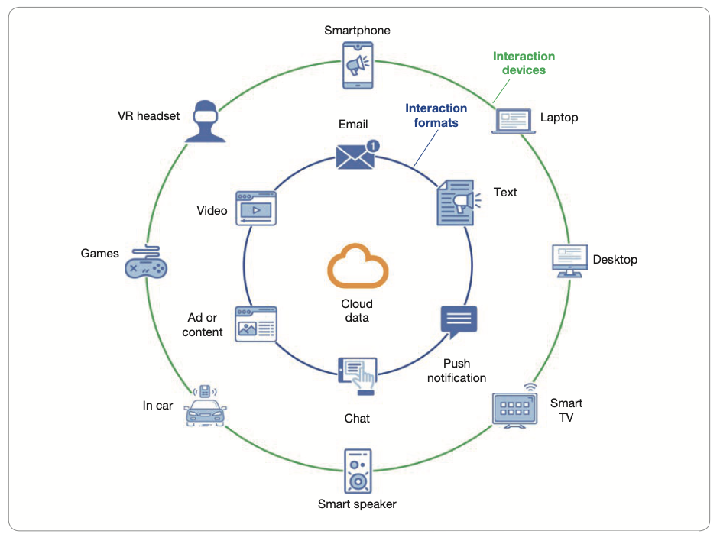
Digital Devices
Consumers receive an overwhelming amount of information via various digital devices
361 billion email / day, globally
75 emails / day for 01 consumer, on average
Huge customer base in online message platform
Notes:
* Facebok, Whatsapp, Wechat có hơn 1 tỉ người dùng tích cực, QQ, Telegram, và Snapchat có khoảng 500 triệu

Slide 6
Dữ liệu số - Dữ liệu lớn
Velocity
Variety
Volume
Data everywhere
Big Data – 3V
Volume
Variety
Velocity
Analyse and application of data creates value
Big Data does not equal Big Value
Start from the basics and avoid “big” method
Notes:
* Creating value using big data – p.15

Slide 7
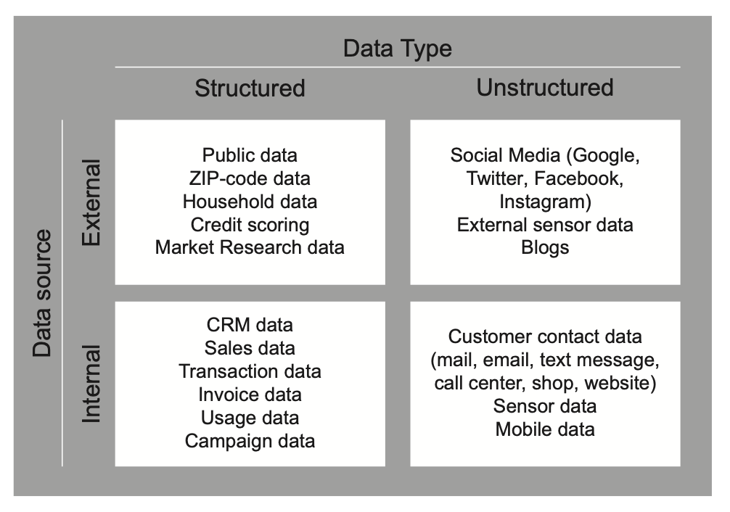
Data
Sources
External
Internal
Types
Structured
Unstructured
Notes:
Creating value using big data analytics – chap 3 – p77

Slide 8
External vs. Internal Data
Not owned by the organisation
Often added/purchased from supplier from outside
Example
Credit Information Center (CIC): credit dossier of customers, provided by VISA/Mastercard to evaluate the customer’s credibility
Data generated from marketing research activities
Notes:
Creating value using big data analytics – chap 3 – p77

Slide 9
External vs. Internal Data
Internal data is already inside the organisation
Trading information, contacts …
Useful for various tasks
Need to be treated before being able to realise value
Notes:
Creating value using big data analytics – chap 3 – p77

Slide 10
Structured vs. Unstructured Data
Structured Data
formated
Labelled and categorised into variables
High quality data
Unstructured Data
Not formated
Various categorisation or no categorisation at all
Need to be treated and simplified before analysis
Notes:
Creating value using big data analytics – chap 3 – p77

Slide 11
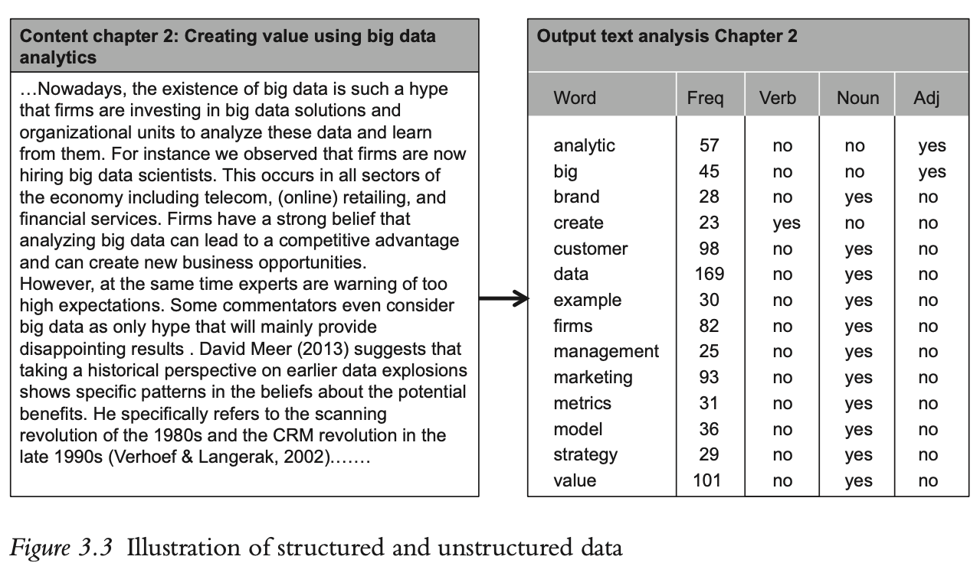
Structured vs. Unstructured Data
Notes:
Creating value using big data analytics – chap 3 – p77

Slide 12
Data Source and Data collection
From inside the organisation
Social network insights
Indicators from Google analytics
Business activities
Operating reports
FRAC*
Data from internal research activities
Survey
Interview
Data Mining
From outside the organisation
Social media listening tools
Purchased from 3rd party organisation
Euromonitors market report
Data Mining service
Notes:
*FRAC = Frequency, Recency, Amount, and Category of purchase - Digital marketing excellence - what is stored in the database - p.461 (what should be captured)
Tổng hợp từ
Digital marketing excellence - what is stored in the database - p.461
Henmann & Burbary, 2013, P. 235

Slide 13
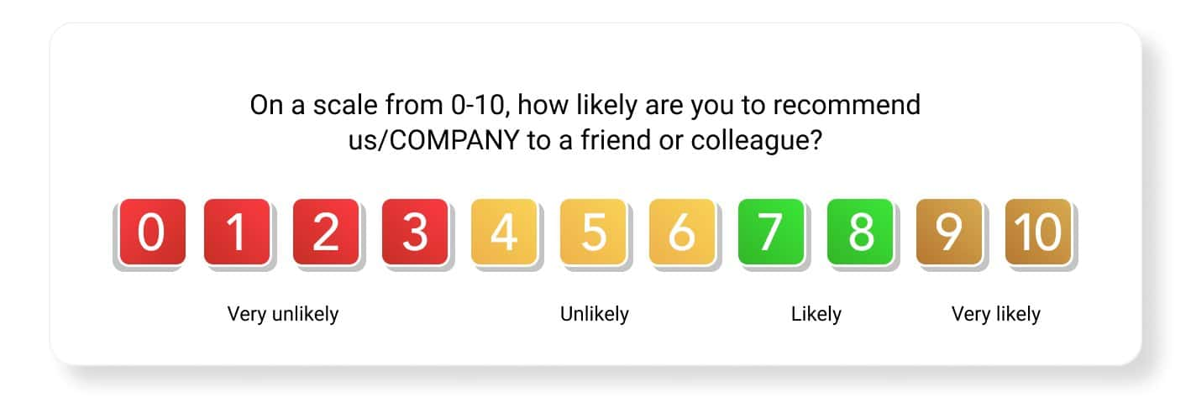
Listen to the customer via digital listening
VoC (Online voice of customer): feedback about customers’ experience
Many techniques: text analytics, sentiment analytics, ….
Find meaning in the feedback data from customer
NPS (Net promoter score):
0)10 scale
3 main groups: promoter (9-10), passive (7-8), and detractor (0-6)
Determine the antecedents of promoter for development

Slide 14

Demo – Real world Dataset
Structured dataset from Kraggle
Starbucks promotional campaign
Analysis example

Slide 15
Starbucks dataset
Nature of dataset: Promotional offers & Multichannels
Available observations:
Transaction (view rate & completion rate)
Customer profile
Offer detail

Slide 16
Starbucks dataset
Analysis done on Python
Available code for replication
However, nothing fancy or new:
univariate analysis
plotting variables against each other
visualisation

Slide 17
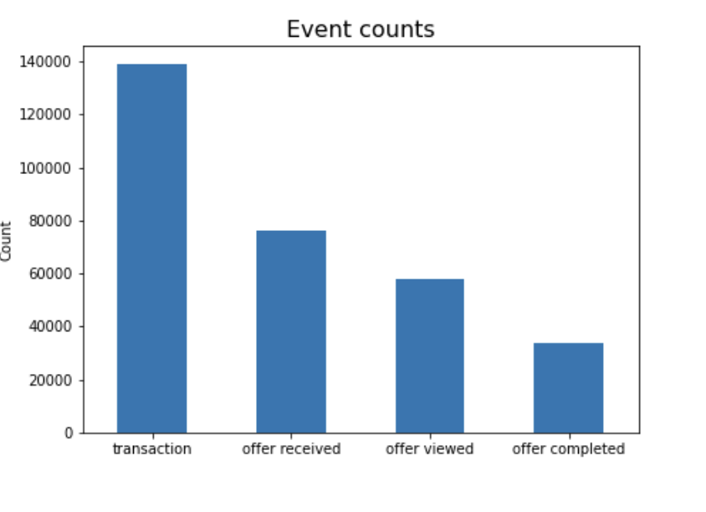
Starbucks dataset
The data itself is meaningless
The analyst/marketer has to tell a story from the data
How would you interpret the data?
Notes:
The data itself does not have anything to say about the strategy or the state of the company
The story is for the marketer to tell
For example, look at the event counts. What can you say about the effectiveness of Starbucks promotional campaign?
Offer = ad /message.... Sent to consumers’ phone, PC, mail....
We record 140k transaction (purchase), 80k offer received, of which 60k get viewed, and around 30k make a transaction out of it.

Slide 18
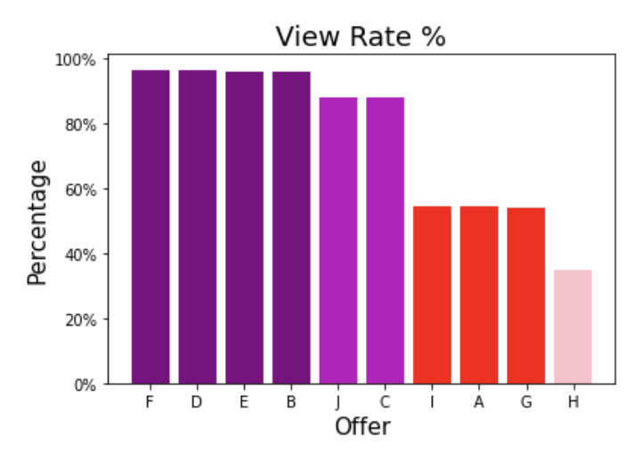
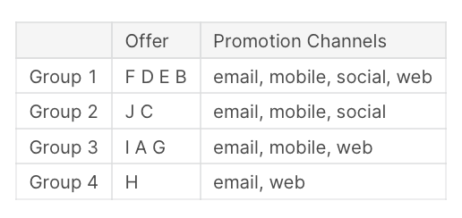
Starbucks dataset
More example
How would you interpret the data?
Notes:
The data show % view on each combination of channel
Here each offer get sent through a set of channels, in group (color coded)
For example, group 1 (purple) has offer F D E B sent through email, mobile, social, web, together.
This group has the highest % view,
While group H, has the lowest % view

Slide 19
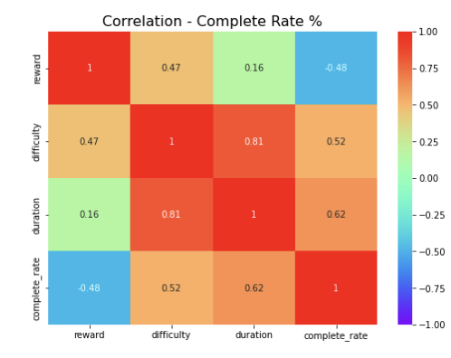
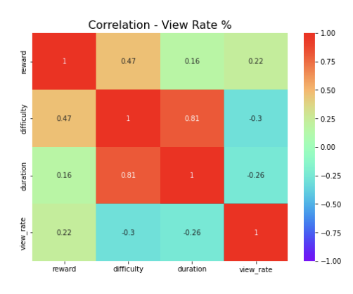
Starbucks dataset
More example
How would you interpret the data?
What should starbucks do?
How many customer category can we infer here?
What should Starbucks do?
Notes:
More example,
Here are the correlation matrix between differnt variables in the dataset
The red indicate strong correlation, aside from the 1 diagonal, we can see there are strong correlations between:
- duration & difficulty
- duration & completion rate
But low correlations between:
- duration and view-rate
- view rate & difficulty
Can you explain the data?

Slide 20

Demo – Real world dataset
Unstructurerd dataset: Product reviews from Amazon
No analysis example

Slide 21
Application of data in marketing activities
Personalisation and mass customisation
Application of AI and Big Data
Segmentation of customers and customer relation

Slide 22
Application of data in marketing activities
Focus on owned media
Data-driven marketing
Use customer information to improve effectiveness via research, analysis, and customize message
Marketing automation
Automatise marketing activities and sales process to achieve more efficient message delivery, often with personalised email or web-based communication

Slide 23
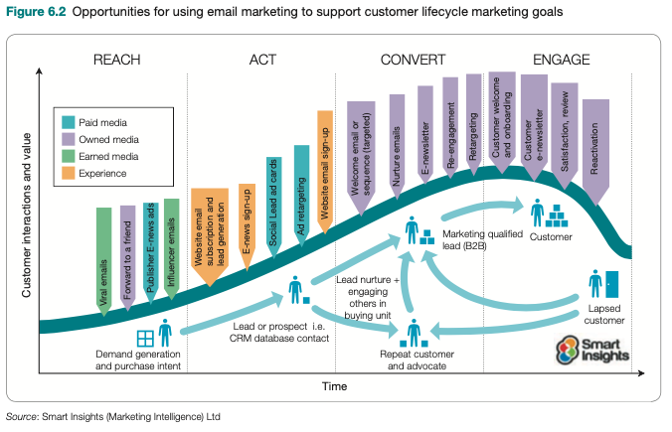
Marketing automation in email marketing
Example of automatic emailing to engage consumers throughout their life cycle

Slide 24
Data-drive marketing techniques
Traditional techniques still in use
Split-test
Hold-out testing
Technology-enabled more complex techniques based on digital dataset to take advantages of the “big” dataset available on online consumer engagement.
Personalisation
Predictive analytics
AI, Big Data
Digital media listening

Slide 25
Example 1: Apply data analytics to improve customer loyalty and value
Listen to consumers via digital media
VoC (Online voice of customer): feedback of customers about their experience
Many techniques
Find meaning in their feedbacks
Example: text analytics, sentiment analytics, ….
NPS (Net promoter score): to measure VoC
0-10 scale
Divide customers into 3 groups: promoter (9-10), passive (7-8), and detractor (0-6)
Determine the antecedent and develop the promoter

Slide 26
Personalisation and Mass customisation
Suggestion based on characteristics, behaviors, or predictive analysis is often known as personalization or mass customisation
Personalisation, or more correctly personalisation of digital experience is to deliver modified content, product suggestion, or service to website audience or app users based on their characteristics and behavioural intention with the target of conversion and long terms engagement.
Mass customization is the creation of personalized marketing message for individual or organization customer via digital mass production

Slide 27
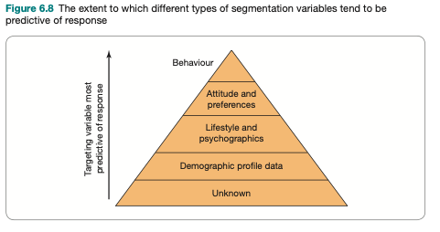
Personalisation and Mass customisation
Organisation collects a large amount of personal data via digital applications
The outcome is personalised message
Targeting pyramid

Slide 28
Personalisation and Mass customisation
Concerns regarding data privacy and manipulation (Tucker, 2014)
Individuals having authority over their privacy settings would react more positively to personalized message
Customer preference centre: an information portal allowing audience to adjust the type and frequency of messages

Slide 29
Role of AI and Big Data
Big Data:
Recognise new trend via big, complex, and multi-dimensional datasets to develop tactics and strategy
Determine the success factors of communication activities, such as the best moment or the best suggestions
AI (Artifical Intelligence):
Application or service fulfilling tasks originally required human intervention and analysis
AI application in Marketing mostly focuses on improving B2C communication, including targeted communication, personalised message, or customer engagement

Slide 30
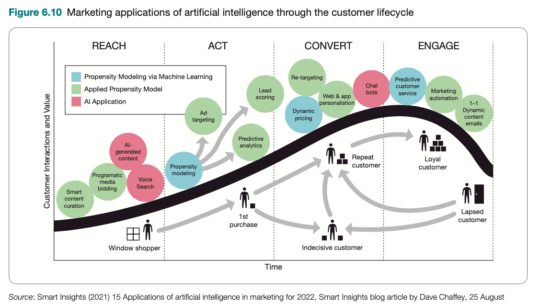
Role of AI and Big Data
Example of using AI to engage customer throughout their lifecycle

Slide 31
Some AI applications in marketing
AI-generated content
Smart content management
Voice search and conversational interface
Content auction
Propensity modelling
Predictive analytics
Lead scoring
Ad targeting

Slide 32
Some AI applications in marketing
Dynamic pricing
Web and application customisation
Chatbots (e.g., BZ Chatbot AI)
Retargeting
Predictive customer service
Marketing automation
Dynamic email content

Slide 33
Exercise 1
Discuss the application of data analytic to improve loyalty (both attitudinal and behavioural loyalty) and customer value

Slide 34
Using data analysis to improve customer loyalty and value
Based on customer online engagement types to the brand
Two types of loyalty: emotional loyalty and behavioural loyalty
Emotional loyalty: manifested as opinion, comment, suggestion, sharing…
Behavioural loyalty: manifested as repeated behaviors, such as purchase, visit, engage, or feedback to marketing activities
Loyalty is closely related to satisfaction
Higher satisfaction indicates higher loyalty
With some exceptions
Need to measure both

Slide 35
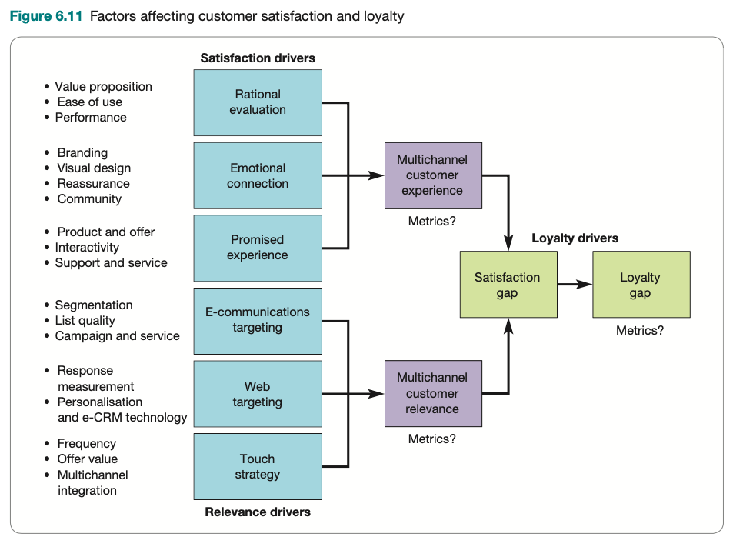

Slide 36
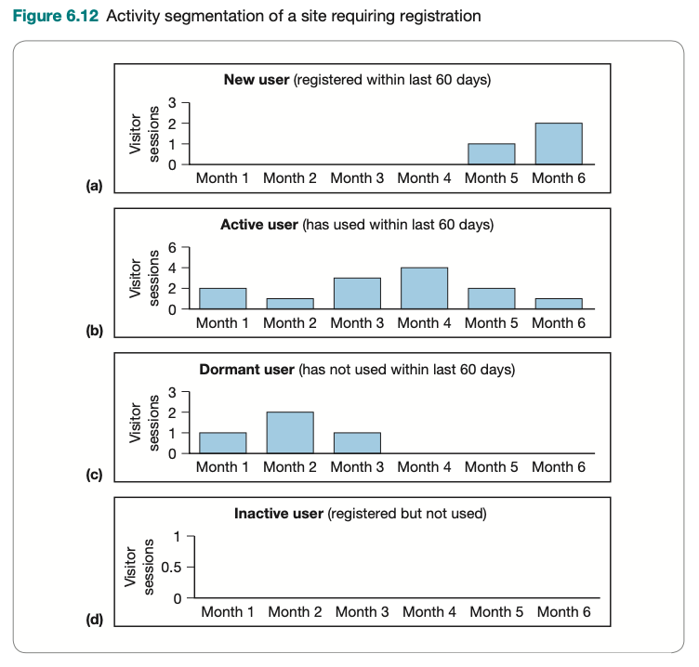
Exercise 2
An organisation use their data (including visitor session / month) to determine the engagement nature of their customer base and divide them into 4 groups:
a. Newly registered users, low engagement rate
b. Active users
c. Registered users but lost interest after a period of usage
d. Registered users but not using sevice (inactive user)
Discuss the strategy needed to address each group. If your resource is not sufficient so you have to prioritise only one category, which would you choose, why?
Notes:
Nguyên tắc tập trung nguồn lực có hạn vào khách hàng giá trị cao
Sử dụng dữ liệu có sẵn để xác định các khách hàng chưa gắn kết và khuyến khích hành vi có lợi
Tiêu chí đo lường tuỳ thuộc vào ngành hàng

Slide 37
Summary
Data source and type
Using dataset in marketing activities
Some data-driven marketing analysis techniques

Slide 38
References
Chaffey D. & Ellis-Chadwick, F. (2022). Digital Marketing: Strategy, implementation, and practice, 8th edition. Pearson: UK.
Hemann, C. & Burbary, K. (2013). Digital marketing analytics: making sense of consumer data in a digital world. Que publishing.
Verhoef, P. C., Kooge, E., Walk, N. (2016). Creating Value with Big Data Analytics, making smarter marketing decisions. Routledge: Newyork.

Slide 39


